Slide 1
New code
Plot 3D covariance ellipsoid
Neuron’s responses to large sample of natural images (100*1000 patches)
Pandas DF for neurons
Pandas DF with sample of neuron pairs

Slide 2
New simulation
500 neurons
12x12 images
1.5M epochs

Slide 3
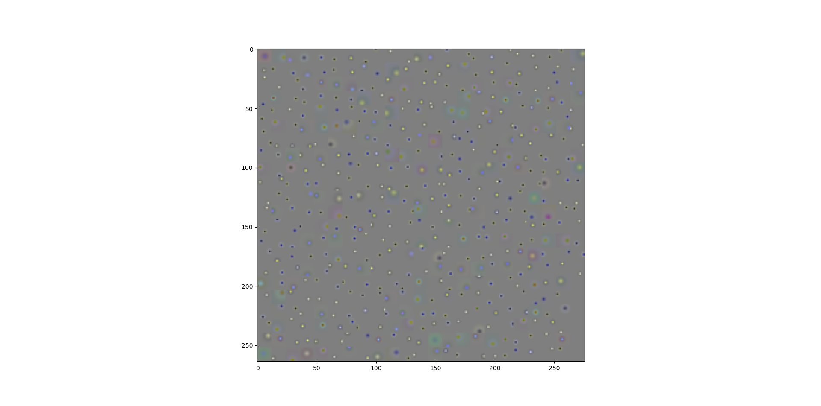

Slide 4
Parameters over time graph

Slide 6
